Slide 1
Test on New VA1140
11/Mar/2022
G. Ambrosi, M. Barbanera, M. Caprai, M. D'Antonio, M. Duranti, M. Ionica, G. Silvestre

Slide 2
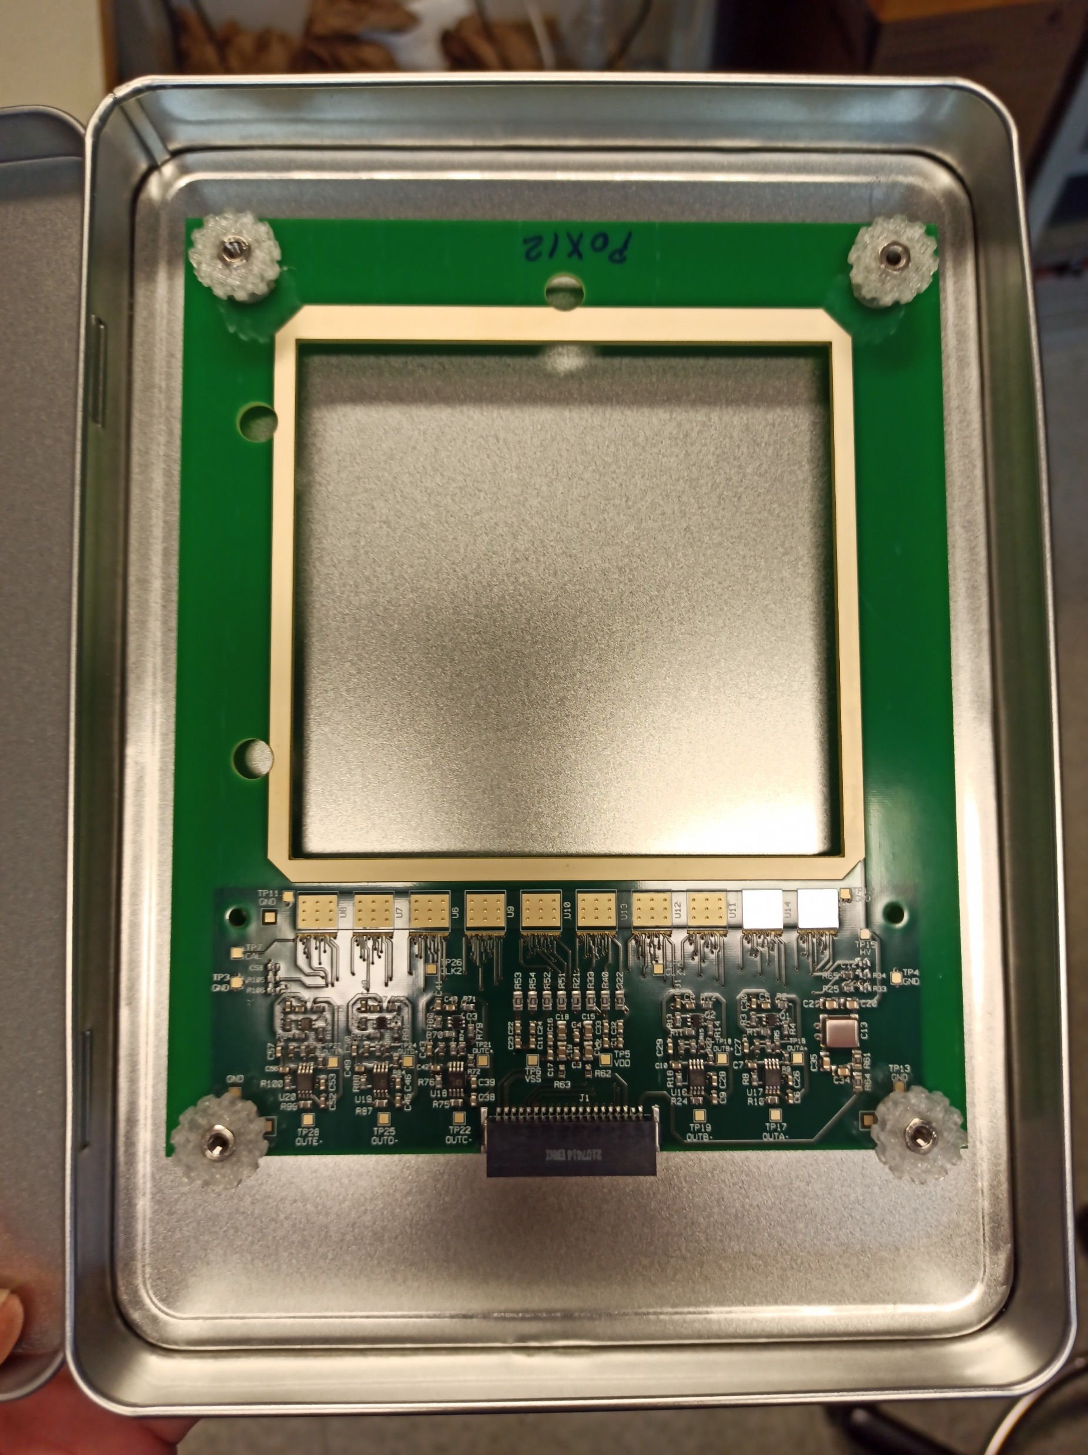
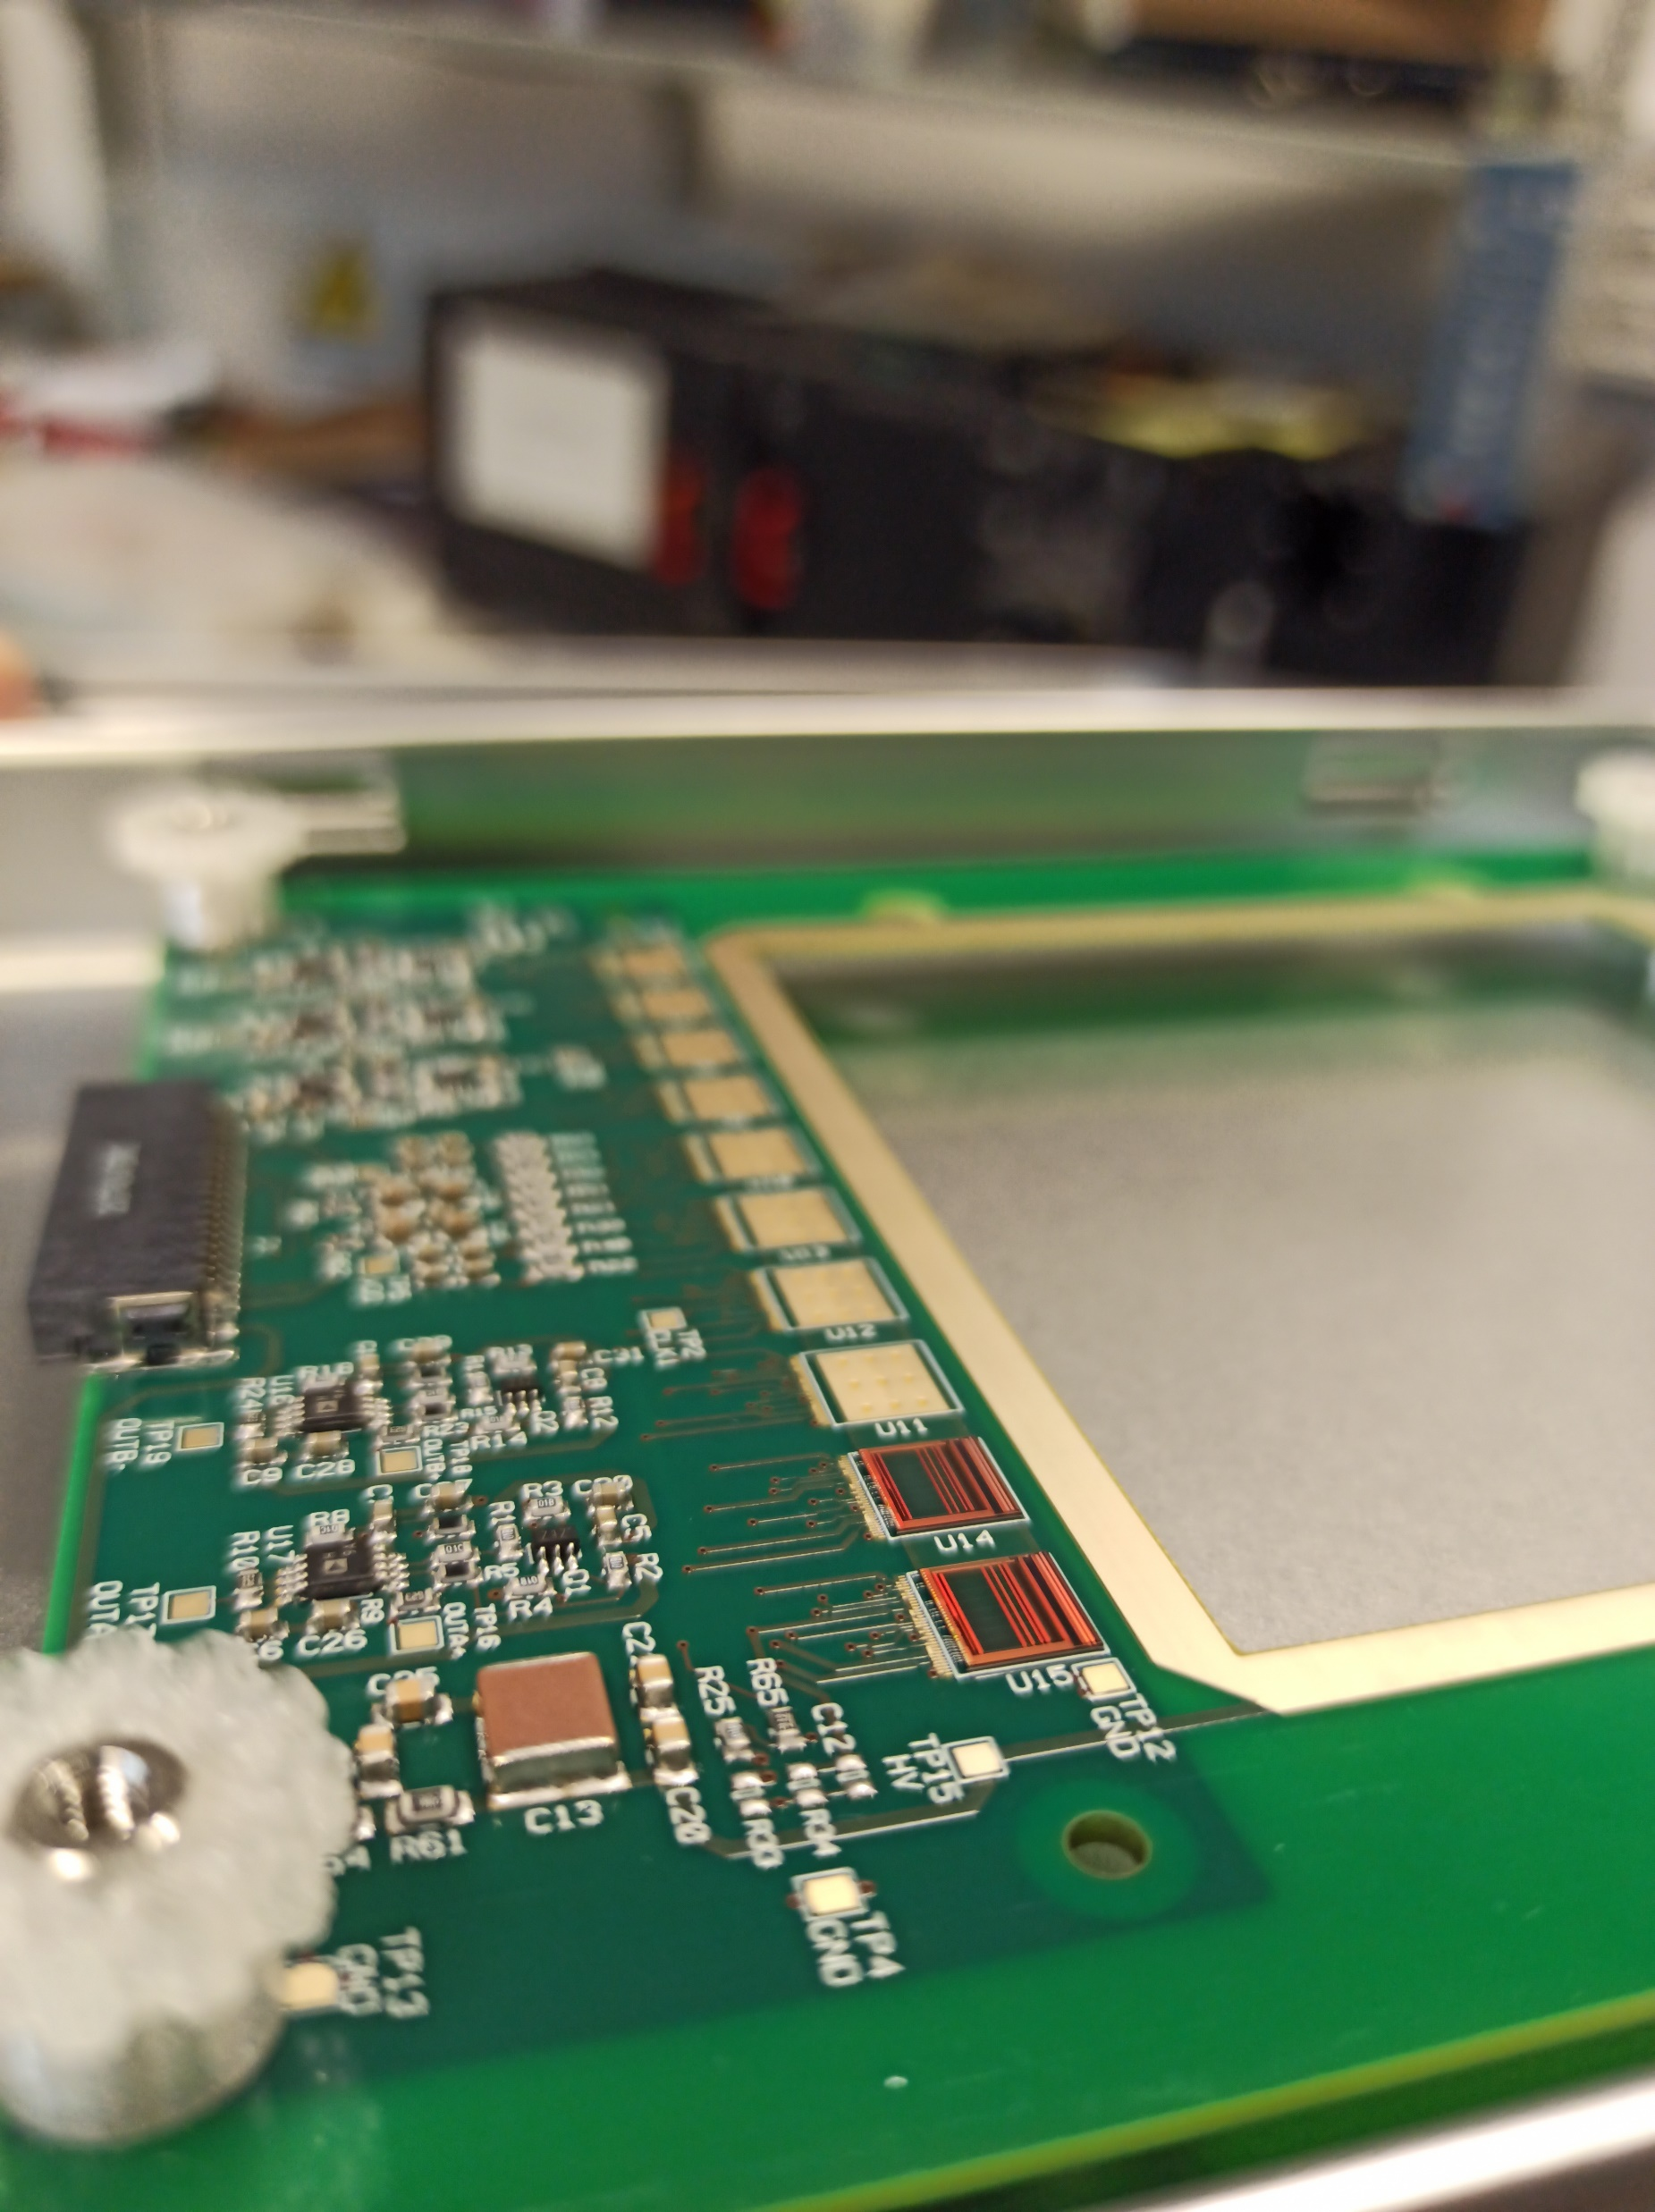
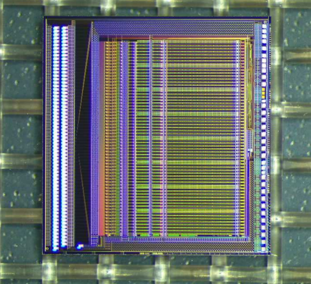
1. Glue 2 "VA1140" on FOOT PCB Hybrid
→ everything is fine

Slide 3
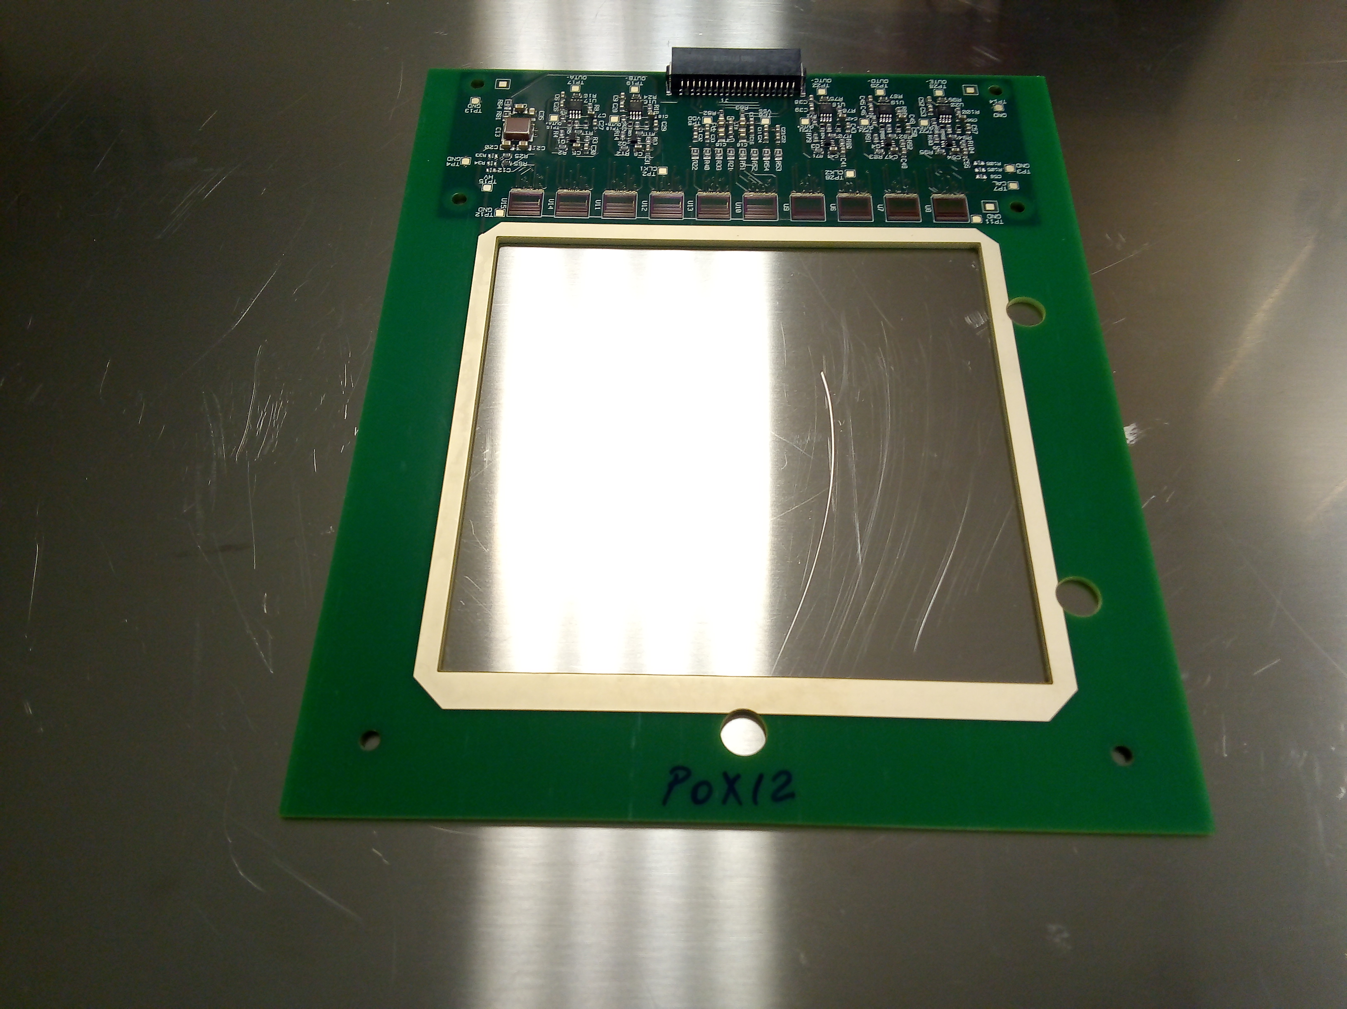
2. Glue the other 8 "VA1140"
Calibration with 10 VA (but no silicon)

Slide 4
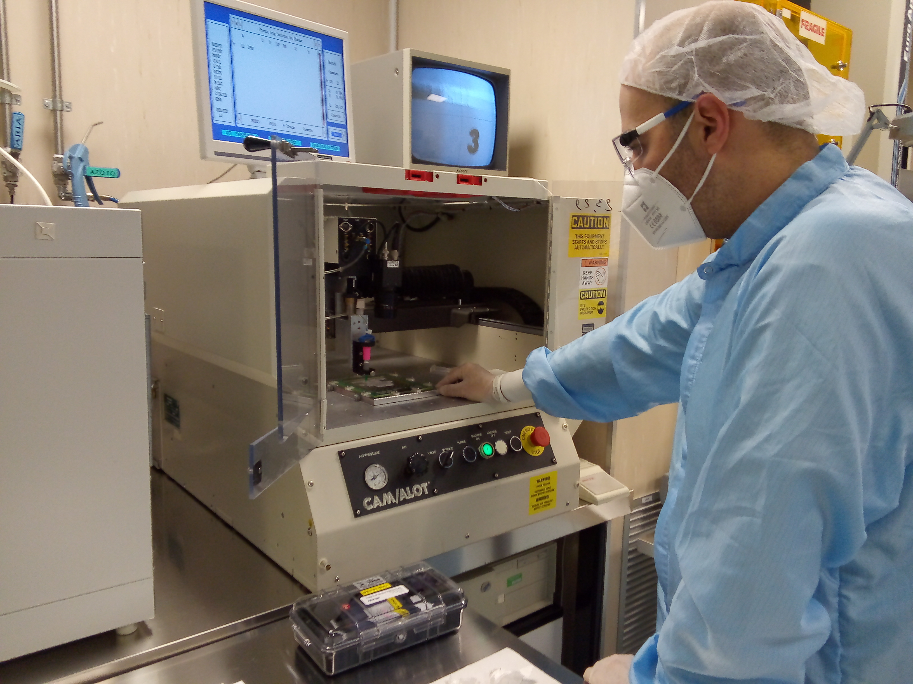
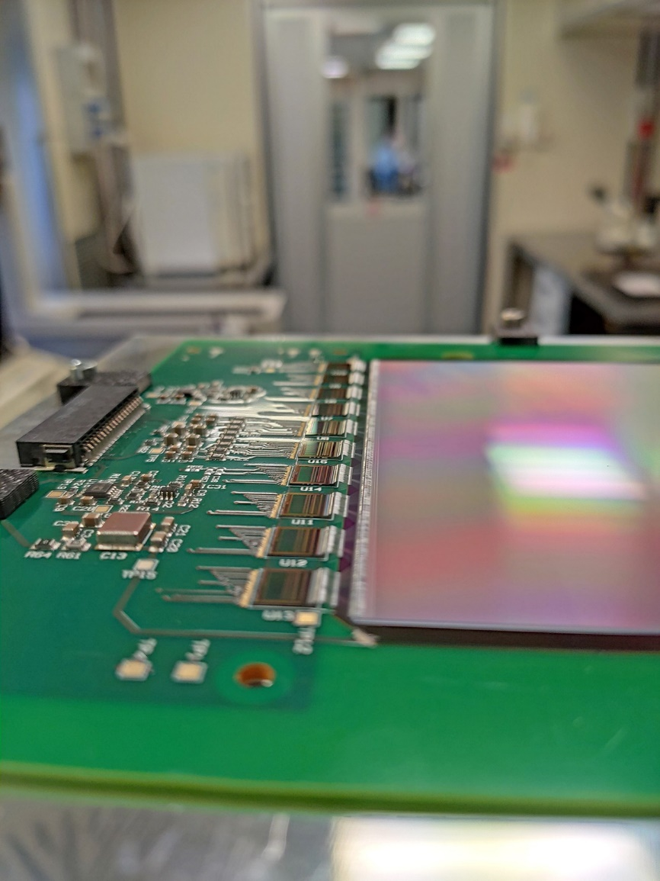
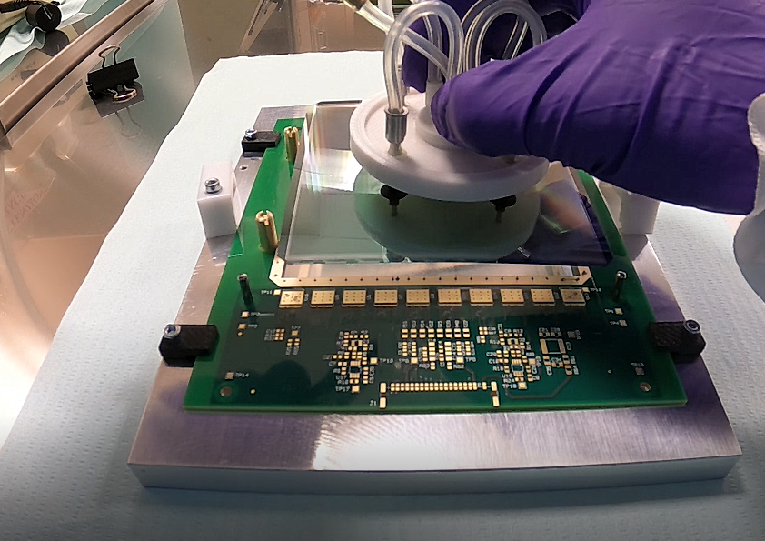
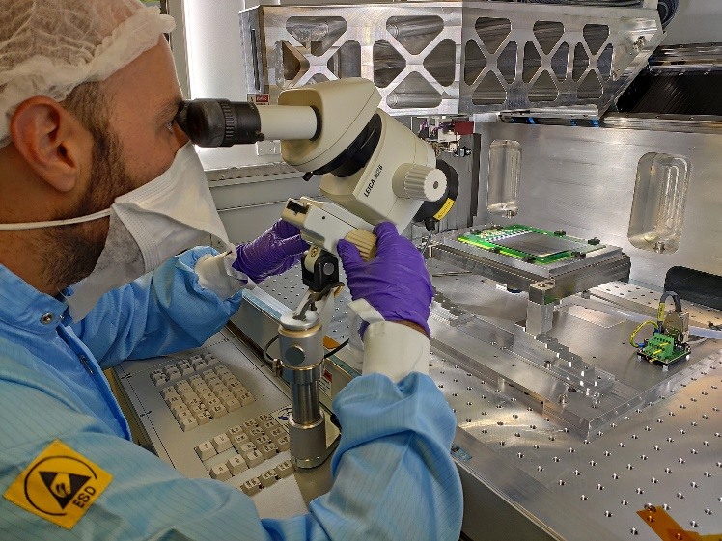
3. Gluing a FOOT silicon sensor
Thickness | 150um
Overall dim | 102.5mmx103.5mm
Active area | 96mm x 96mm
Strip pitch | 50 um
Readout pitch in Foot | 150 um
Number of readout strips | 640
Dispensing the conductive glue (Epotek EJ2189) and siliconic glue (DC 3145 grey) for the silicon sensor gluing on PCB
Calibration with sensors
Positioning the silicon sensor on the PCB
Performing wire bonding

Slide 5
FOOT-newVA: pedestals
FOOT sensor:
+ new batch of VAs
Thickness | 150um
Overall dim | 102.5mmx103.5mm
Active area | 96mm x 96mm
Strip pitch | 50 um
Readout pitch in Foot | 150 um
Number of readout strips | 640
channel
FOOT-newVA: sigma
FOOT-newVA: sigma raw
channel
channel

Slide 6
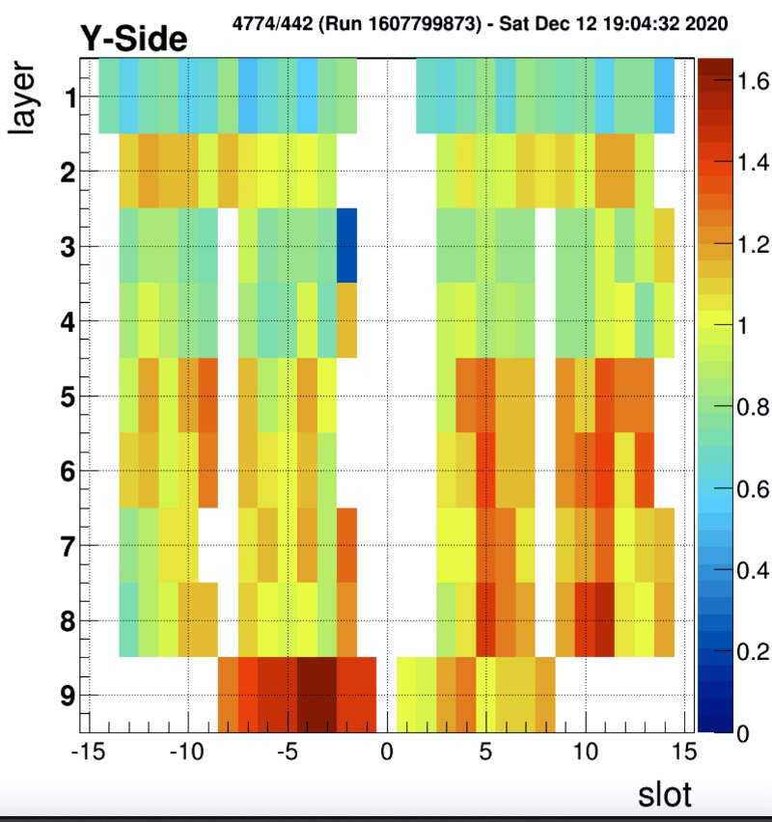
AMS-flight ladder:
- Layer2
- "slot" 9
channel
channel
channel

Slide 7
FOOT-newVA: pedestals
FOOT-newVA: sigma
FOOT-newVA: sigma raw
channel
channel
channel
channel
channel
channel

Slide 8
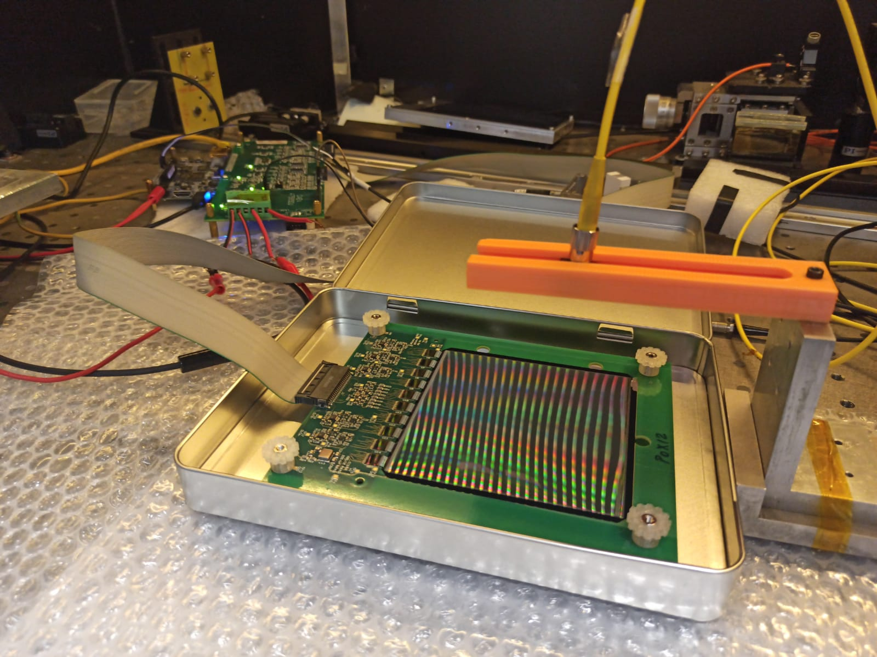
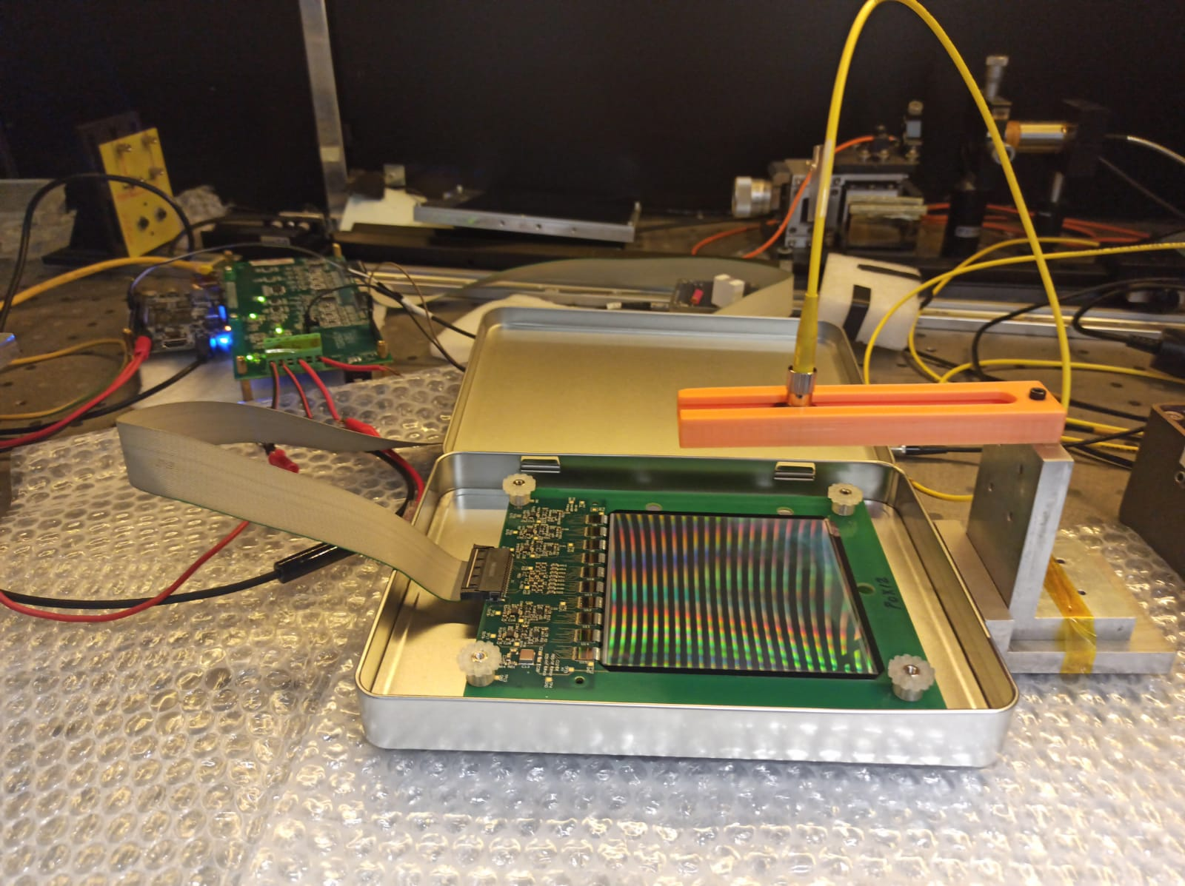
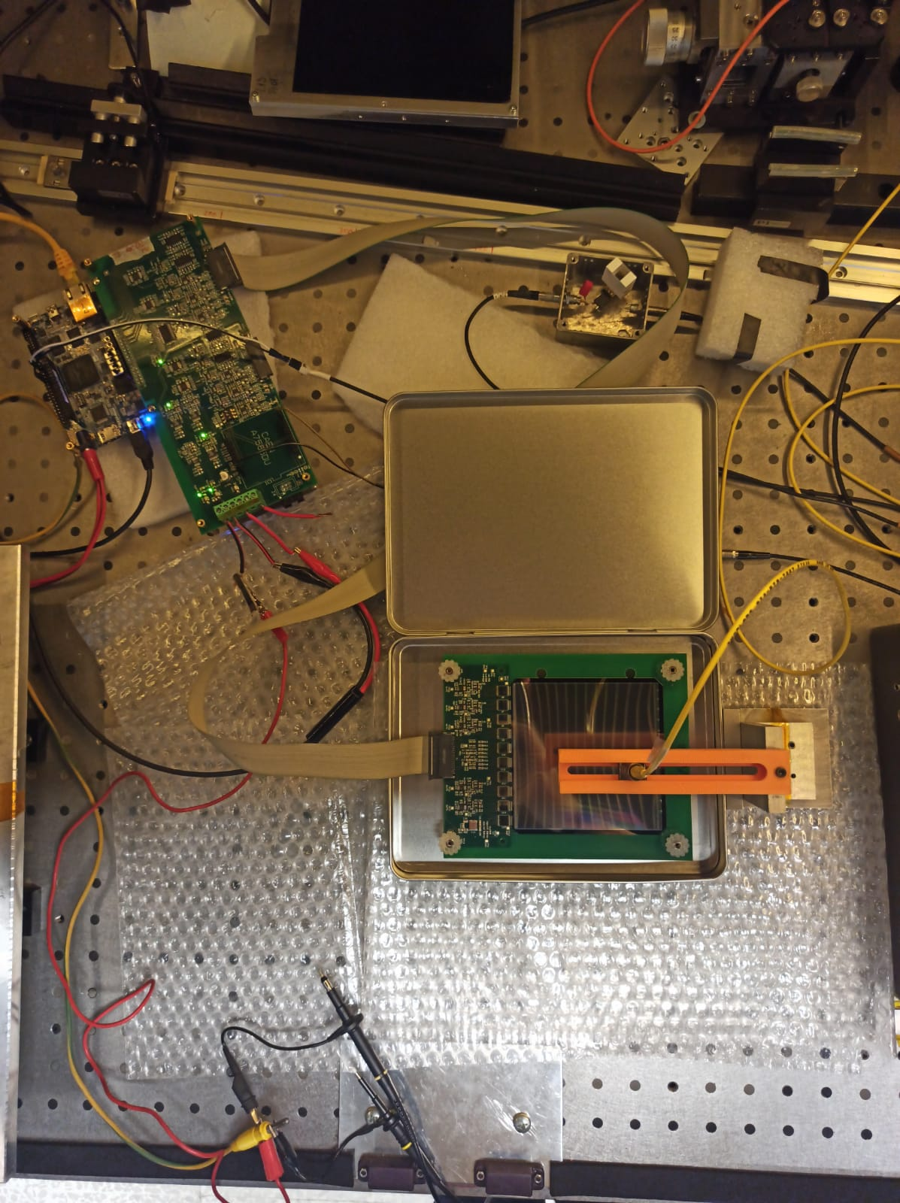
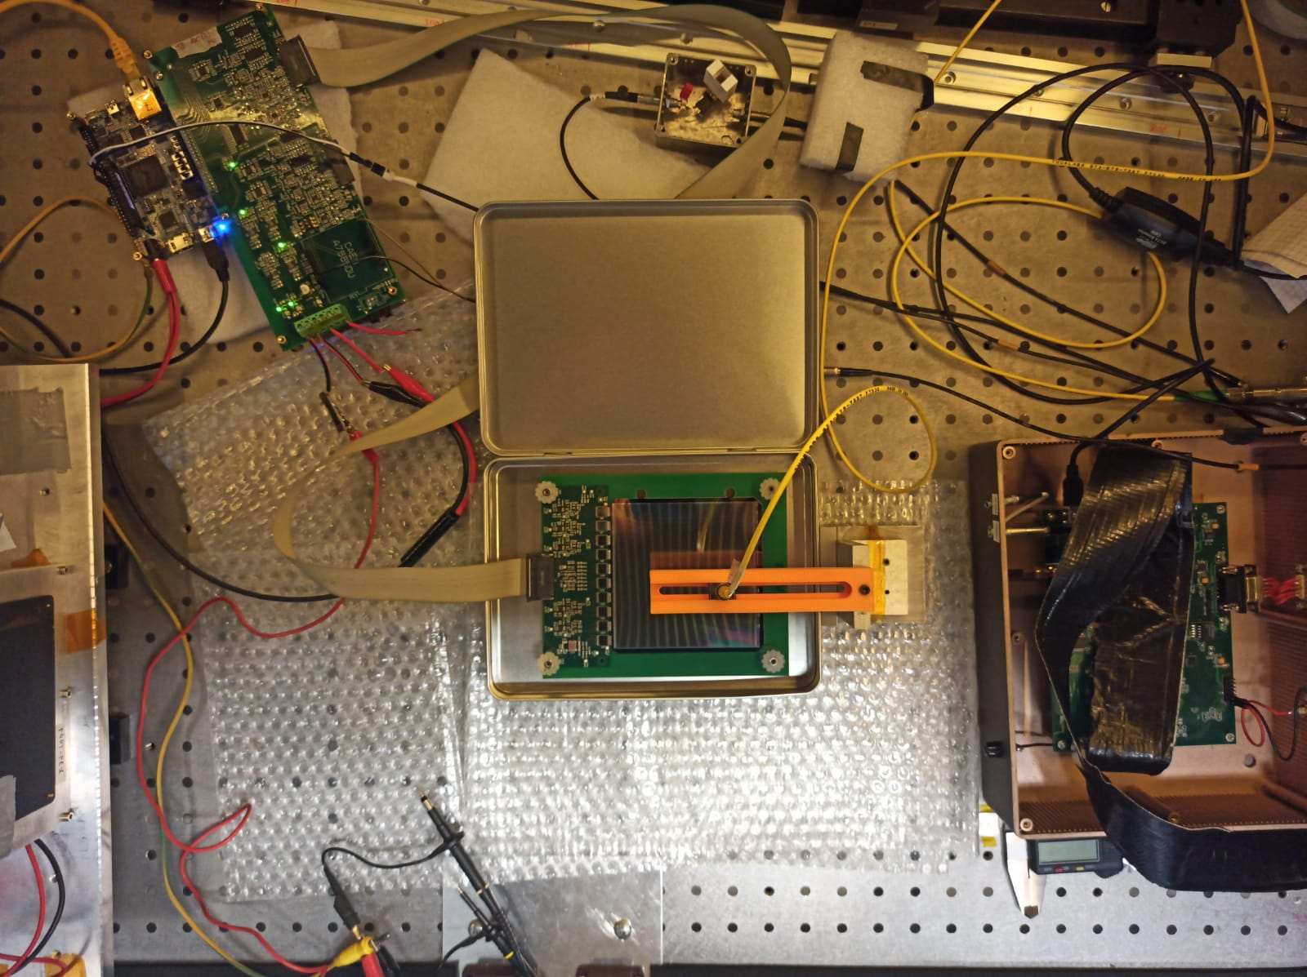
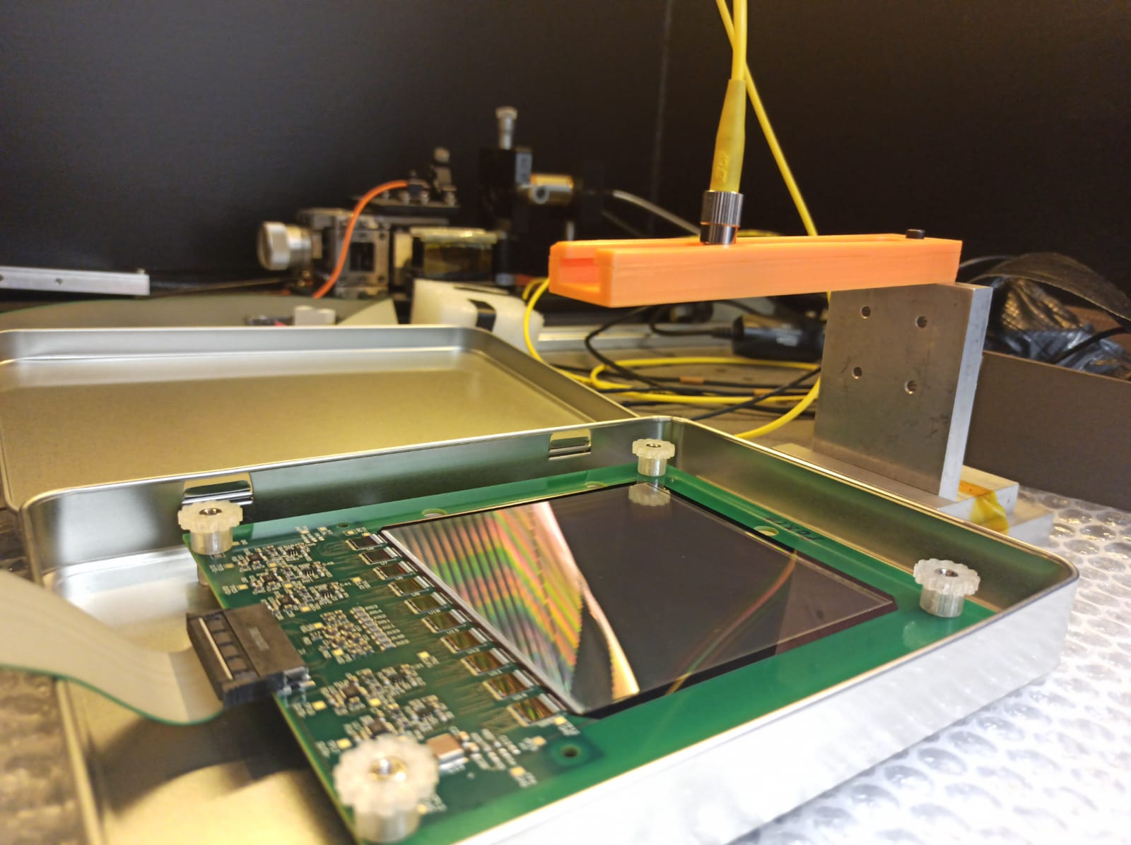
3. Test with laser

Slide 9
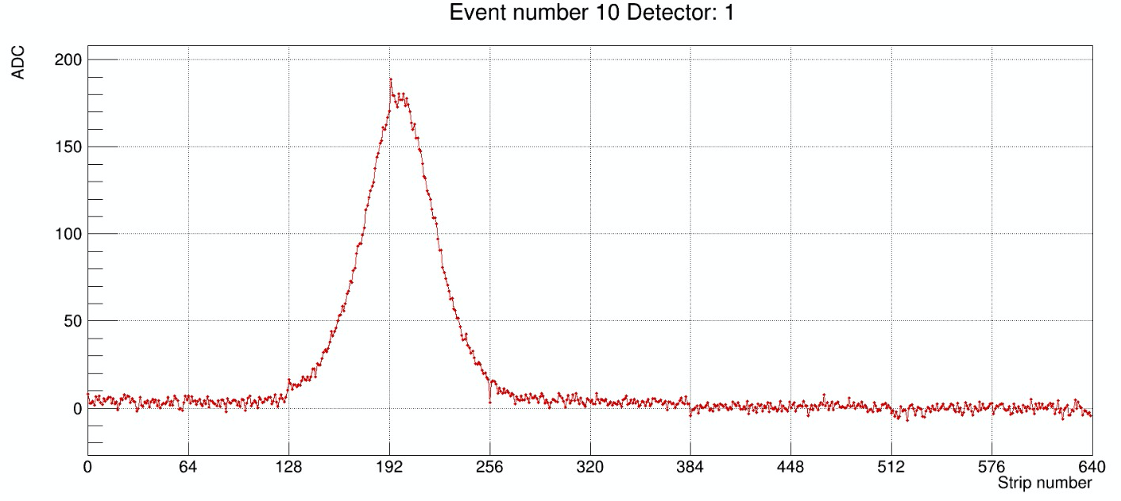
3. Test with laser

Slide 10
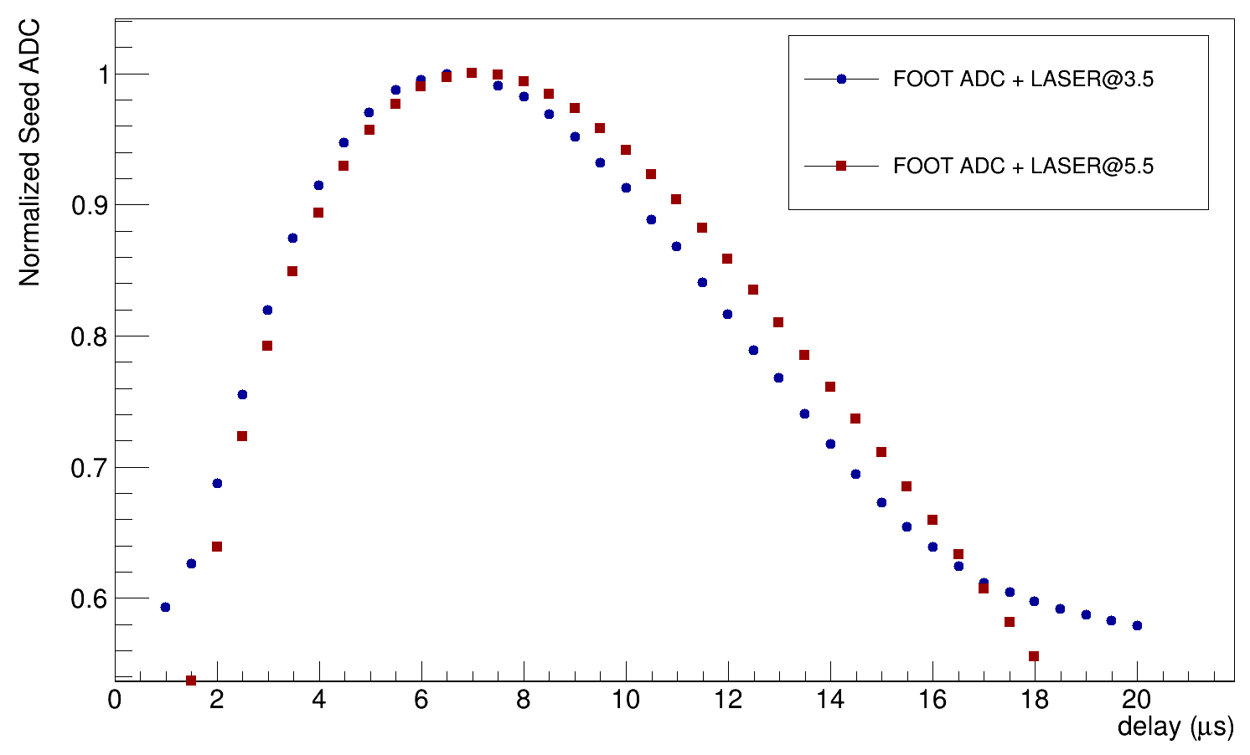
3. Scan in "trigget to hold"

Slide 11
4. Power consumption
Current: measured (datasheet) @ voltage → power consumption
V_{DD}: 1.67 mA (1.3 mA) @ 1.5V → 2.505 mW
V_{SS}: 6.37 mA (9.5 mA) @ -2.0V → 12.74 mW
Total consumption per chip: 15.245 mW
Consumption per channel: ~ 0.25 mW
Total consumption per ladder ~ 0.26 W
Total consumption per L0 (72 ladders) ~ 18 W

